Slide 1
Electric Forces

Slide 3
How do electric charges interact?
a charged object does not have to touch another charged object to apply a force to it.
There are two types of electric charge—positive charge and negative charge.
oppositely charged particles attract each other.
Similarly charged particles repel each other.
The invisible region surrounding a charged object is called an electric field.
It applies an electric force to other charged objects, even when the objects are not touching. This means that an electric force is a noncontact force. The electric force applied by an object’s electric field either attracts or repels other charged objects.

Slide 5
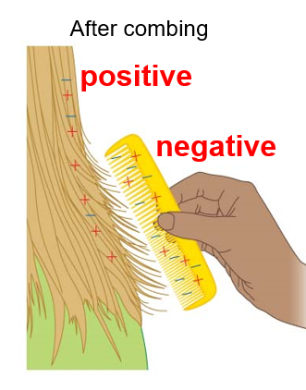
What determines the strength of an electric field?
The strength of the electric force between two charged objects depends on two variable
—the total amount of electric charge on both objects
— and the distance between the objects.
When you brush your hair, charged particles move from the brush to your hair. This causes the brush and your hair to each have a static charge. The brush is negatively charged; your hair is positively charged. The brush and your hair attract each other.

Slide 6
Electric Field Strength
Brushing your hair once or twice transfers some charged particles from the brush to your hair. The force of attraction is not very strong. More brushing transfers more charged particles from the brush to your hair.
It increases the strength of the electric force of attraction between the brush and your hair.
Distance also affects the strength of the electric force between electric charges.
Brushing your hair produces an unbalanced positive charge on the brush and an unbalanced negative charge on your hair.
Electric fields surround these electric charges. The fields are more intense near the charges. A more intense electric field applies a stronger electric force to other objects.
When the brush is close to your hair, the force of attraction is very noticeable. As the distance between charged objects increases, the electric force between them decreases.

Slide 7
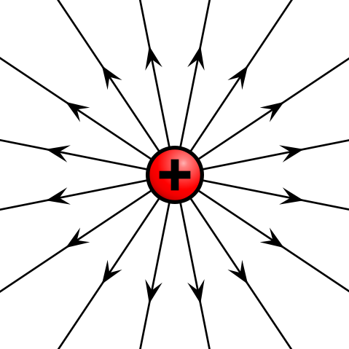
What happens when electric fields interact?
You now know that the strength of an electric field depends on the distance and the size of the electric charge on the objects.
What do you think the field would look like if there were both positive and negative charges? How do you think their fields would interact?

Slide 8
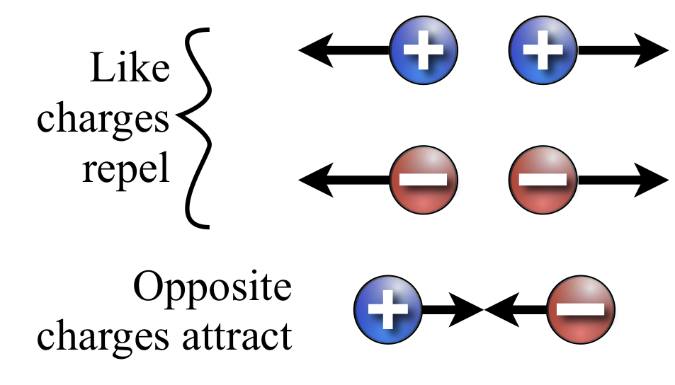
Electric Potential Energy
Stored energy due to interactions of charges in an electric field is called electric potential energy.
When two opposite charges attract each other, a force must be applied to keep the opposite charges apart. When the force is applied, energy is added to the electric charges. This means the electric potential energy between the two charges increases..

Slide 9
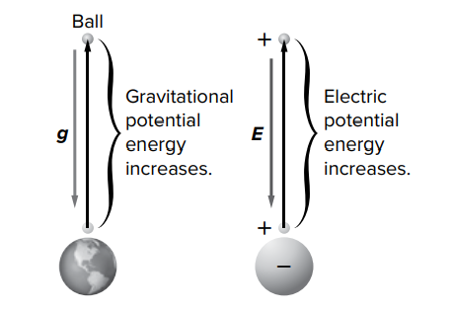
Electric Potential Energy
Electric potential energy depends on the size of the charges and the distance between the two charges.
The electric potential energy is greater with larger charges.
It is also larger when the distance between the charges is greater.

Slide 10
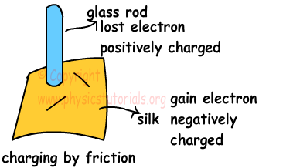
Charged Objects
When charged particles move from one electrically neutral object to another, both objects become electrically charged.
An object is electrically charged when it has an unbalanced amount of positive charge or negative charge
. An object that has lost charged particles as it comes in contact with another object has an unbalanced electric charge

Slide 11
Neutral Object
All objects contain charged particles.
When an object has equal amounts of positive charge and negative charge, the charges are balanced ( uncharged ).
An object with equal amounts of positive charge and negative charge is electrically neutral.
Electrically neutral objects do not attract or repel each other.
But Neutral objects can be attracted to charged objects.

Slide 12
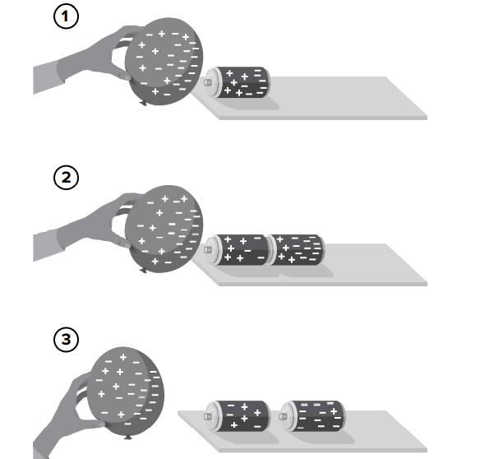
Charged particles
Charged particles can transfer between objects. In the figure below, a negatively charged balloon is brought near cans.
The negative charges in the cans are pushed away from the balloon. The result is negative charges in the farther can and positive charges in the can closest to the balloon.
This method of charging an object is called induction.
Induction is the charging of an object without touching it.

Slide 13
Conductors and Insulators
An electric insulator is a material in which charges cannot easily move. Glass, rubber, wood, and air are good electric insulators.
A material in which charged particles can easily move is an electric conductor. Most metals, such as copper and aluminum, as good electric conductors

Slide 14
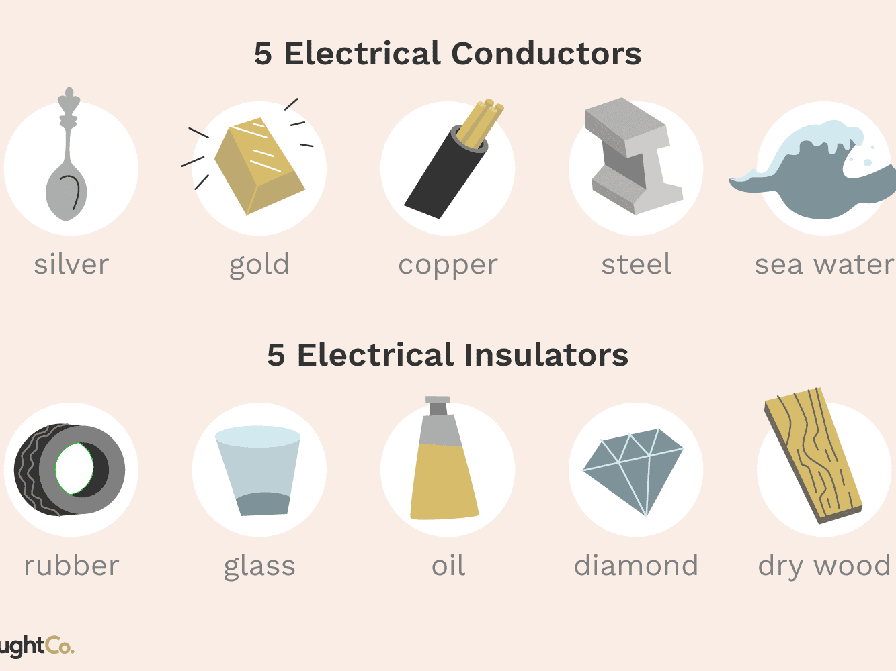

Slide 16
Transferring Charge
When conducting objects with unequal charges touch, charged particles flow from the object with a greater concentration of negative charge to the object with a lower concentration of negative charge, as shown in the figure below. The flow continues until the concentration of charge on both objects is equal.
Transfer of charged partciles between two conductors is conduction. This is similar to water flowing from a container with a higher water level to a container with a lower water level.

Slide 19
Conservation of Charge
The amount of water in the example illustrated above did not change. The amount of water in the full container at the beginning of the procedure is the same as the amount of water after the two containers became equal.
The total charge in the system also does not change. The total charge in a closed system does not change

Slide 20
Inspire science lesson check

